Slide 1
COURSE NAME – Cloud and devops COURSE CODE:22CS2243F
Cohort-E27 (SEDP)
Software engineering mis and Devops
prepared by :Anjaneyulu .G
Topic:
introduction to cloud computing

Slide 2
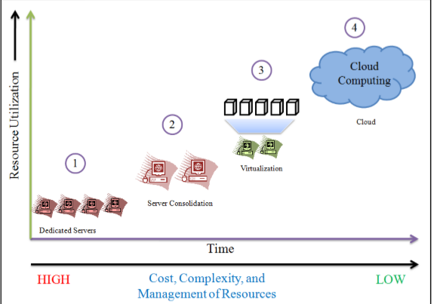
Cloud computing
Cloud computing is regarded as a groundbreaking innovation of recent years.
It is reshaping the technology landscape. With breakthroughs made in appropriate service and business models, cloud computing has expanded to its role as a backbone for IT services.
Based on experience, organizations improved from dedicated servers to consolidation and then to virtualization and cloud computing

Slide 3
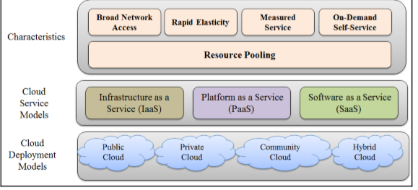
It has opened various opportunities in terms of the availability of application—deployment environments, considering three service models and four deployment models as shown in the following diagram

Slide 4
There are four cloud deployment models, each addressing specific requirements:
Public cloud: This cloud Infrastructure is available to the general public
Private cloud: This cloud Infrastructure is operated for and by a single organization
Community cloud: This cloud infrastructure is shared by specific community that has shared concerns
Hybrid cloud: This cloud infrastructure is a composition of two or more cloud models

Slide 5
public cloud
Public clouds are managed by third parties which provide cloud services over the internet to the public, these services are available as pay-as-you-go billing models.
They offer solutions for minimizing IT infrastructure costs and become a good option for handling peak loads on the local infrastructure. Public clouds are the go-to option for small enterprises, which can start their businesses without large upfront investments by completely relying on public infrastructure for their IT needs.

Slide 6
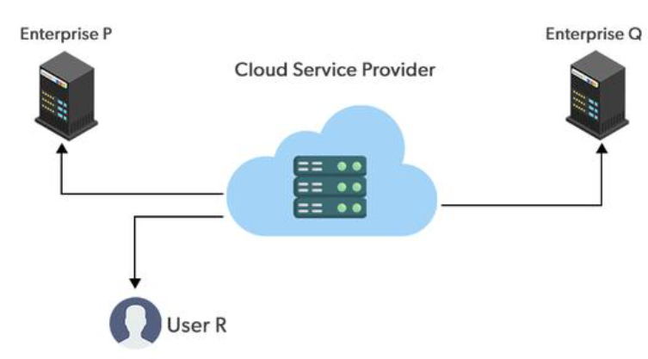
The fundamental characteristics of public
clouds are multitenancy.
A public cloud is meant to serve multiple
users, not a single customer.
A user requires a virtual computing
environment that is separated, and most likely
isolated, from other users.
Examples: Amazon EC2, IBM, Azure, GCP

Slide 7
advanatages& disadvantages
Public cloud is easily able to scale up and down resources as per the demand of traffic and workload. It facilitates with performance optimization and cost efficiency.
It works on pay-as-you-go cloud model and helps in resolving the investments needs in hardware and infrastructure reducing overall costs.
It is difficult to trust and maintain data to a third-party provider may raise concerns about control and ownership
The shared infrastructure of public cloud resources increases the risk of data breaches and unauthorized access. It raises security and privacy concerns.
Public cloud comes with limited transparency about the underlying infrastructure which may make it challenging to monitor and manage performance effectively.

Slide 8
private cloud
Private clouds are distributed systems that work on private infrastructure and provide the users with dynamic provisioning of computing resources. Instead of a pay-as-you-go model in private clouds, there could be other schemes that manage the usage of the cloud and proportionally billing of the different departments or sections of an enterprise. Private cloud providers are HP Data Centers, Ubuntu, Elastic-Private cloud, Microsoft, etc.
Examples: VMware vCloud Suite, OpenStack, Cisco Secure Cloud, Dell Cloud Solutions, HP Helion Eucalyptus

Slide 9
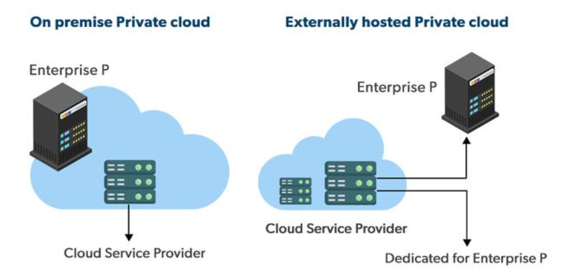
advantages &disadvantages
Customer information protection: In the private cloud security concerns are less since customer data and other sensitive information do not flow out of private infrastructure.Infrastructure ensuring SLAs: Private cloud provides specific operations such as appropriate clustering, data
replication, system monitoring, and
maintenance, disaster
recovery, and other uptime services.

Slide 10
Compliance with standard procedures and operations: Specific procedures have to be put in place when deploying and executing applications according to third-party compliance standards. This is not possible in the case of the publ
The restricted area of operations: Private cloud is accessible within a particular area. So the area of accessibility is restricted.
Expertise requires: In the private cloud security concerns are less since customer data and other sensitive information do not flow out of private infrastructure. Hence skilled people are required to manage & operate cloud services.

Slide 11
hybrid cloud
A hybrid cloud is a heterogeneous distributed system formed by combining facilities of the public cloud and private cloud.
For this reason, they are also called heterogeneous clouds.
A major drawback of private deployments is the inability to scale on-demand and efficiently address peak loads.
Here public clouds are needed. Hence, a hybrid cloud takes advantage of both public and private clouds.
Examples: AWS Outposts, Azure Stack, Google Anthos, IBM Cloud Satellite, Oracle Cloud at Customer

Slide 12
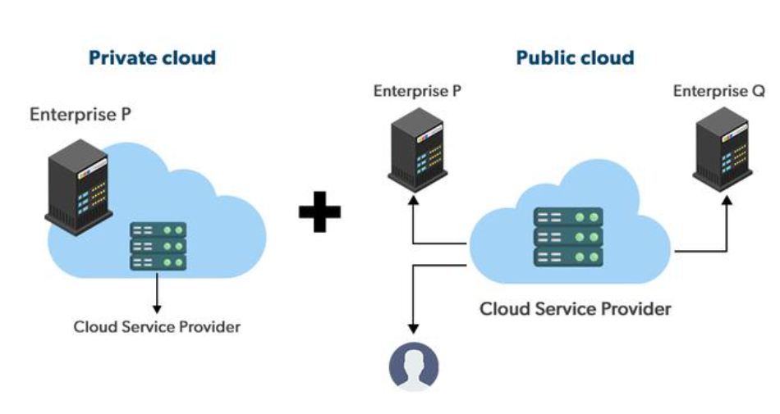
advantages & disadvanatages
Hybrid cloud is available at a cheap cost than other clouds because it is formed by a distributed system.
It works comes up with working fast with lower
cost and facilitates reducing the latency data transfer
process.
Most important thing is security. A hybrid cloud is
totally
safe and secure because it works on the distributed
system network.

Slide 13
It’s possible that businesses lack the internal knowledge necessary to create such a hybrid environment.
Managing security may also be more challenging. Different access levels and security considerations may apply in each environment.
Managing a hybrid cloud may be more difficult. With all of the alternatives and choices available today, not to mention the new PaaS components and technologies that will be released every day going forward, public cloud and migration to public cloud are already complicated enough. It could just feel like a step too far to include hybrid.

Slide 14
community cloud
Community clouds are distributed systems created by integrating the services of different clouds to address the specific needs of an industry, a community, or a business sector. But sharing responsibilities among the organizations is difficult.
In the community cloud, the infrastructure is shared between organizations that have shared concerns or tasks. An organization or a third party may manage the cloud.
Examples: CloudSigma, Nextcloud, Synology C2, OwnCloud, Stratoscale

Slide 15
Because the entire cloud is shared by numerous enterprises or a community, community clouds are cost-effective.
Because it works with every user, the community cloud is adaptable and scalable. Users can alter the documents according to their needs and requirements.
Public cloud is less secure than the community cloud, which is more secure than private cloud
Not all businesses should choose community cloud.
Gradual adoption of data
It’s challenging for corporations to share duties.

Slide 16
references
https://dzone.com/articles/learn-how-to-setup-a-cicd-pipeline-from- scratch
https://aws.amazon.com/getting-started/projects/set-up-ci-cd-pipeline/
https://xebialabs.com/periodic-table-of-devops-tools/
https://xebialabs.com/the-ultimate-devops-tool-chest/
https://aws.amazon.com/getting-started/tutorials/continuous- deployment-pipeline/
https://medium.com/@tomershaiman/building-a-ci-cd-pipeline-on-
azure-kubernetes-service-aks-part-1-5d2b3a7968ca
http://microservices.today/CI-CD-Solution-with-AWS/

